Slide 1



Slide 2

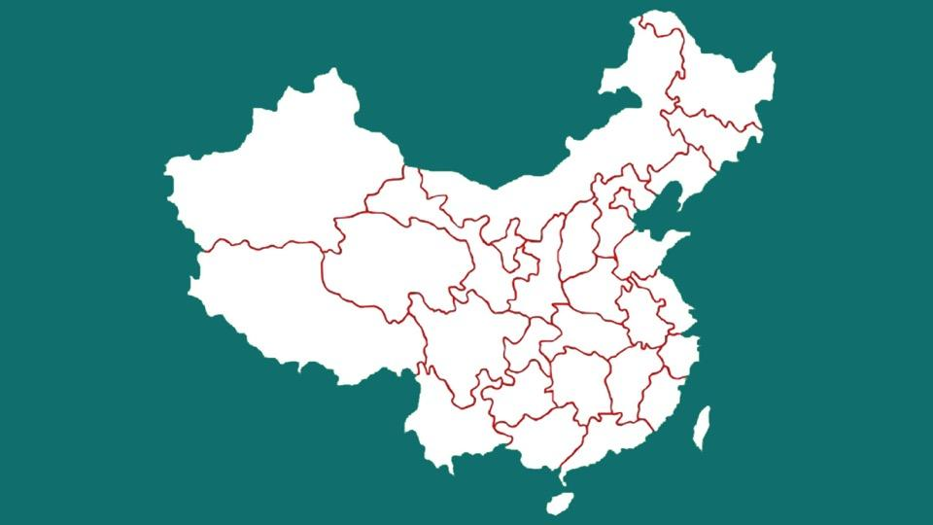
We opened in Beijing on September 2012
Huizhou office (Guangdong) launched in 2014

Slide 3
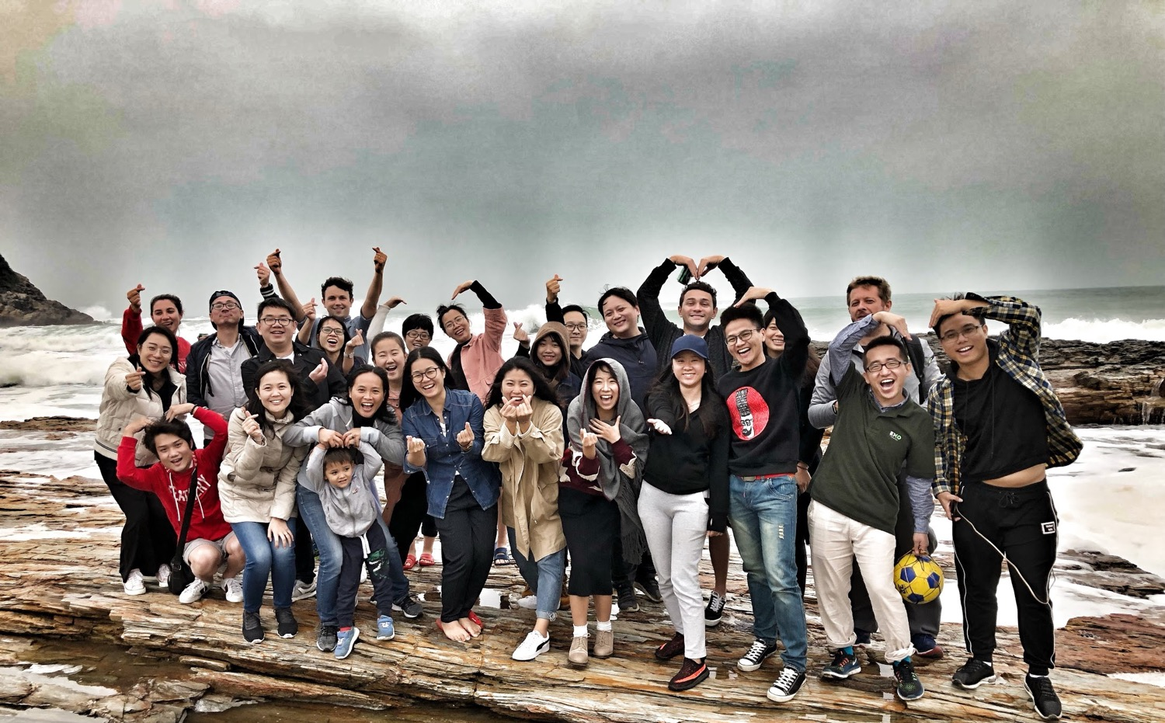
Everything we do as a team is to bring all our strength, energy and fun spirit to help and support our internal and external customers to be at their best in what they do so that China will a be a top end destination to work and travel in.

Slide 4
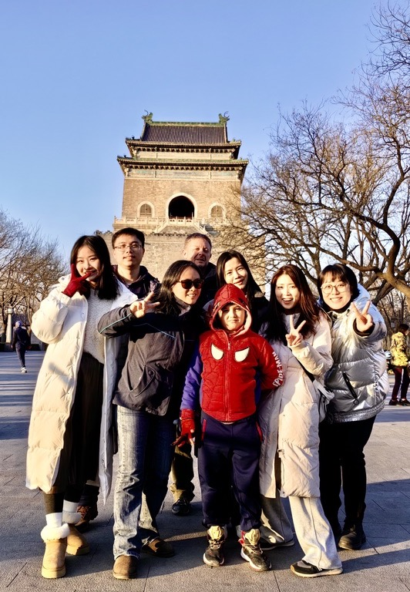
With 12 years of operations in China, we humbly acknowledge our vast experience in handling a diverse range of clients in this remarkable country. We have worked painstakingly to curate an extensive portfolio of tours and experiences, aiming to showcase China in a unique light. Our unwavering commitment to upholding the highest standards of service and professionalism, coupled with our dedication to delivering exceptional and unparalleled travel experiences, has been instrumental in setting Lost Road apart from others in our field.
HEADING FONT:
ROBOTO Bold, 24 point
BODY TEXTS FONT:
ROBOTO, 12 point

Slide 5

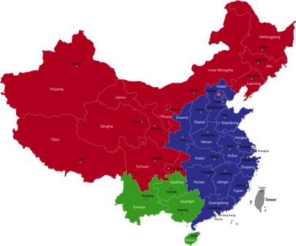
Great Landscape
Classical China
Southwest & Minorities

Slide 6
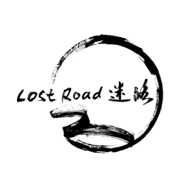
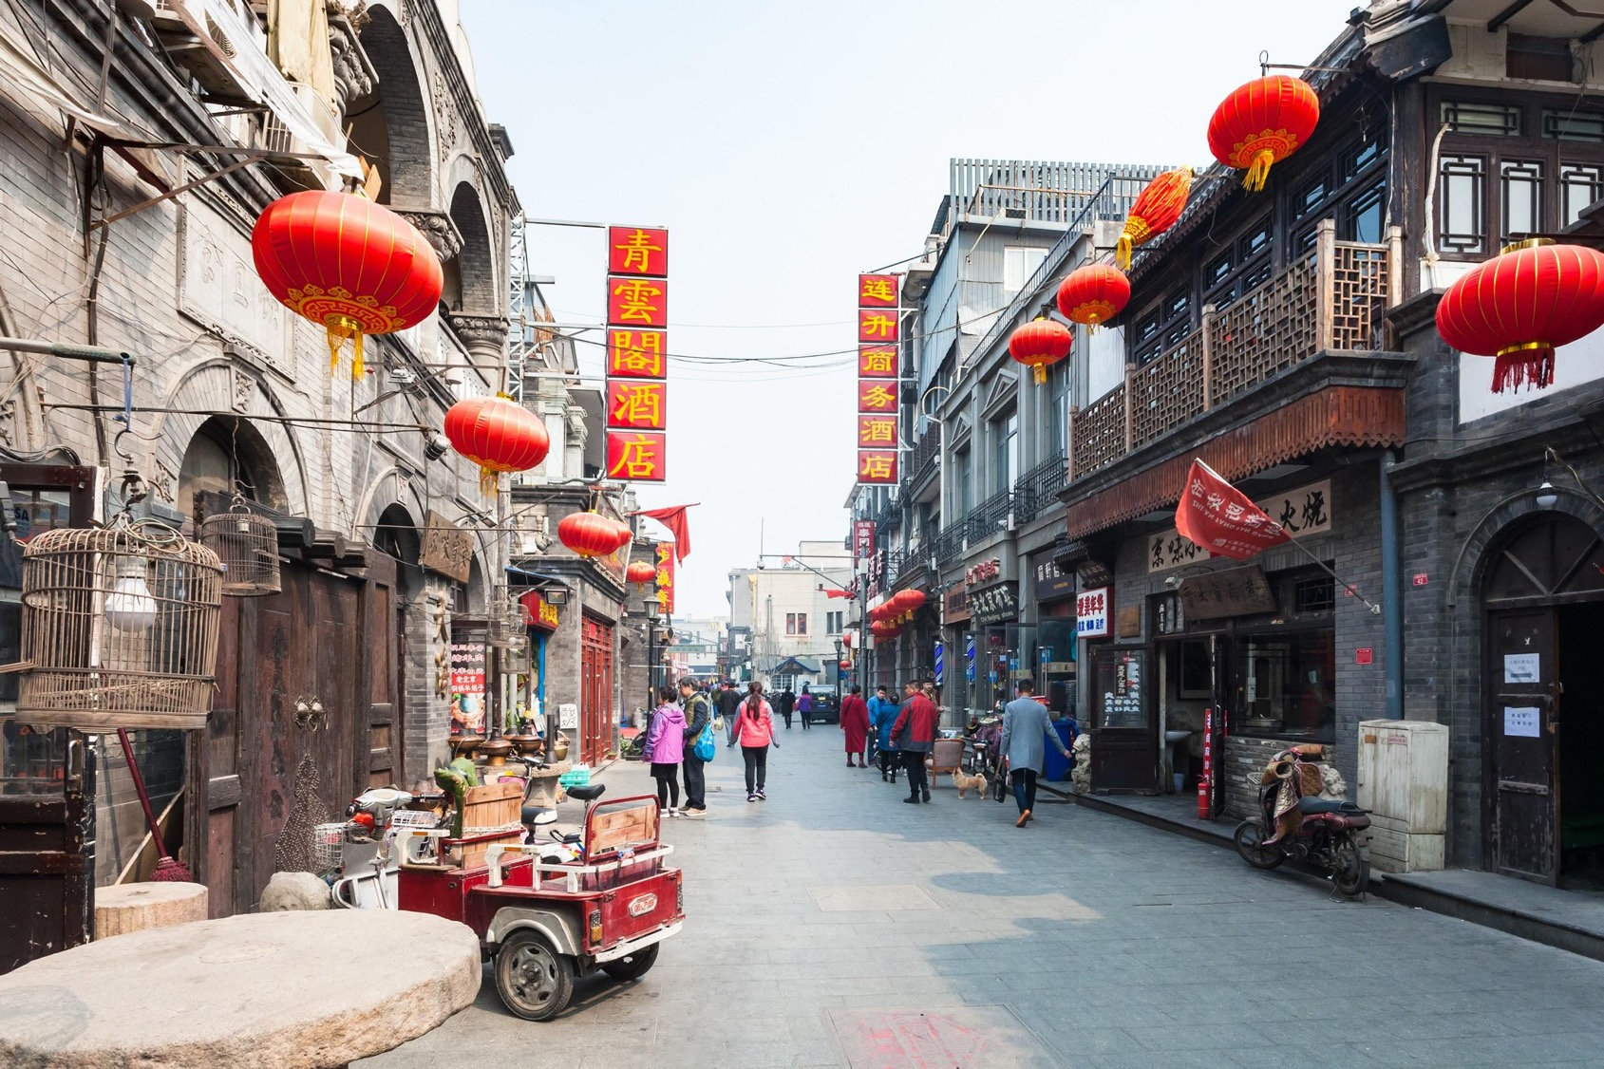

Slide 7
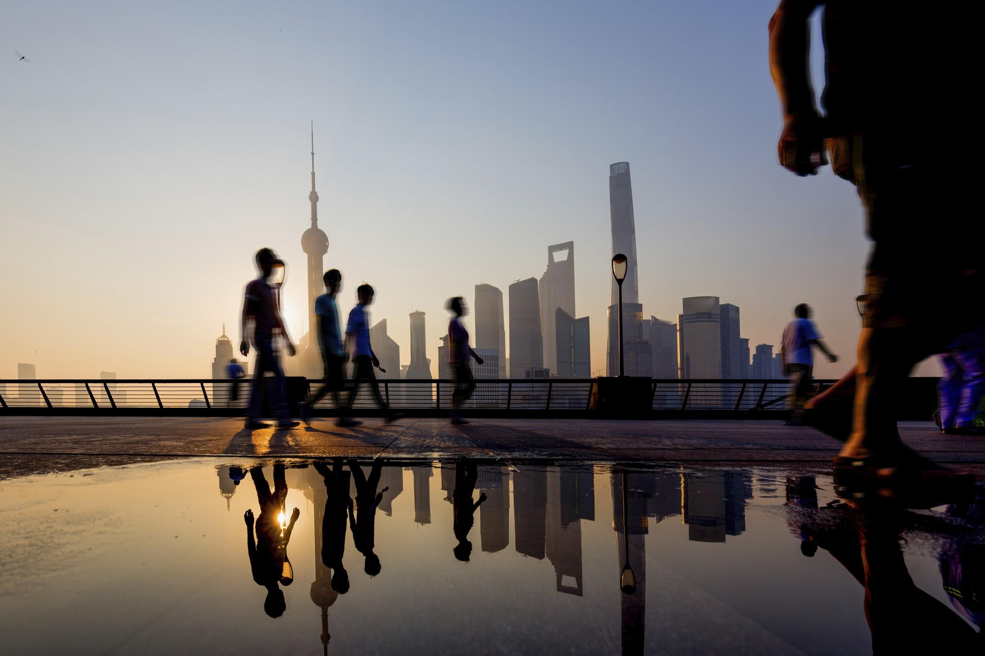
SHANGHAI

Slide 8
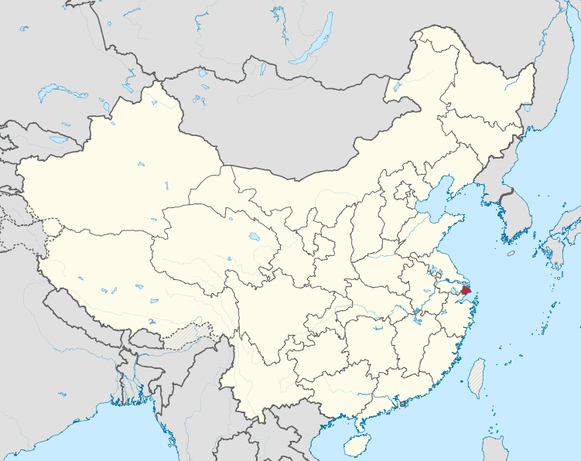
SHANGHAI

Slide 9
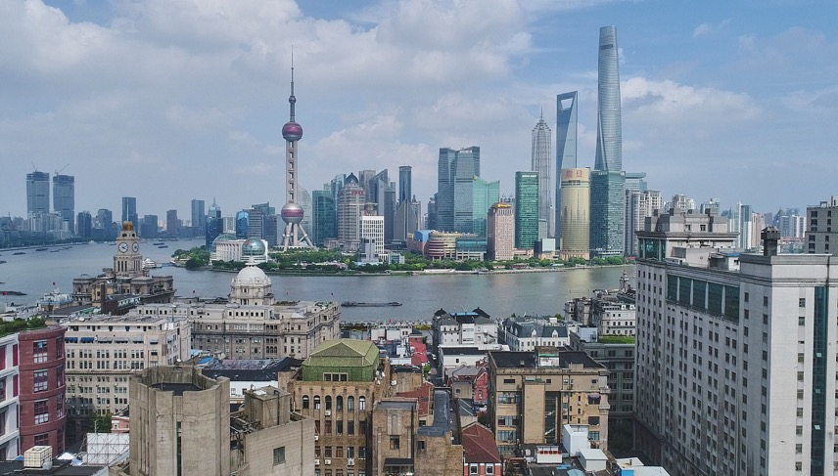
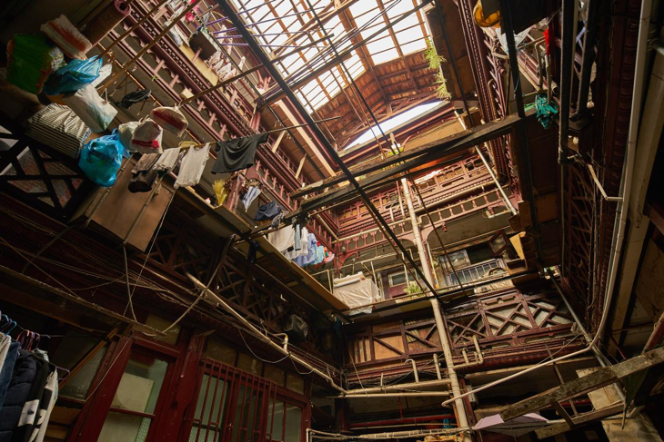
Cycling
WALKING TOUR(s) - with specialists
Secrets of the former French concession
It is an incredible journey transporting you from hidden lanes, where we uncovered architectural gems, to more frequented streets which can be unrolled for you like magic parchment
The Bound behind the scenes
The Bund is a "Must-see" of Shanghai and the majority of the visitors or expats only scratch the surface of this architectural gem
Jewish tour
Taking a half-day tour illustrating the remarkable history of Jews in Shanghai with our specialized Jew guide

Slide 10

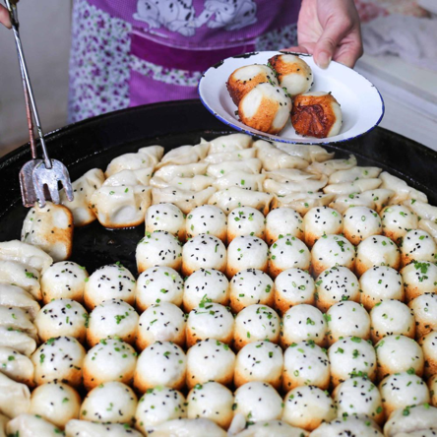
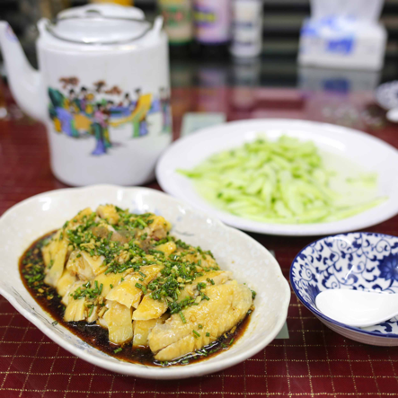
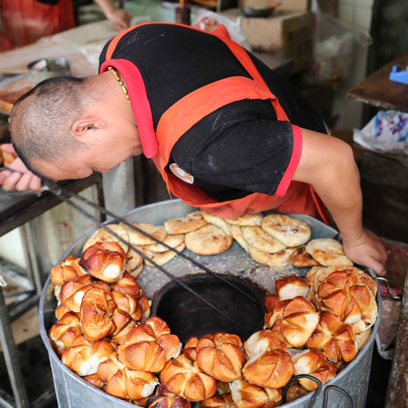
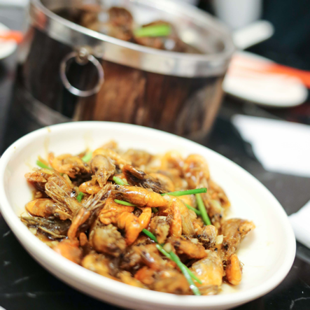
FOODIE TOUR(s)
Old Shanghai breakfast tour / Evening tour

Slide 11

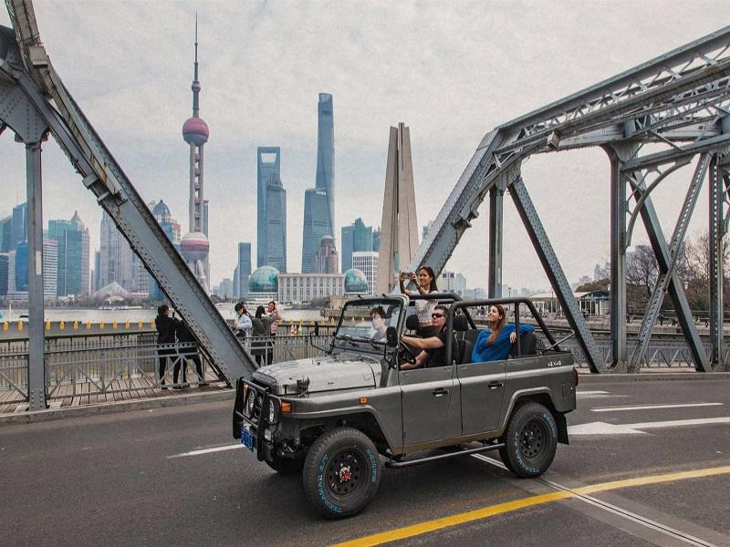
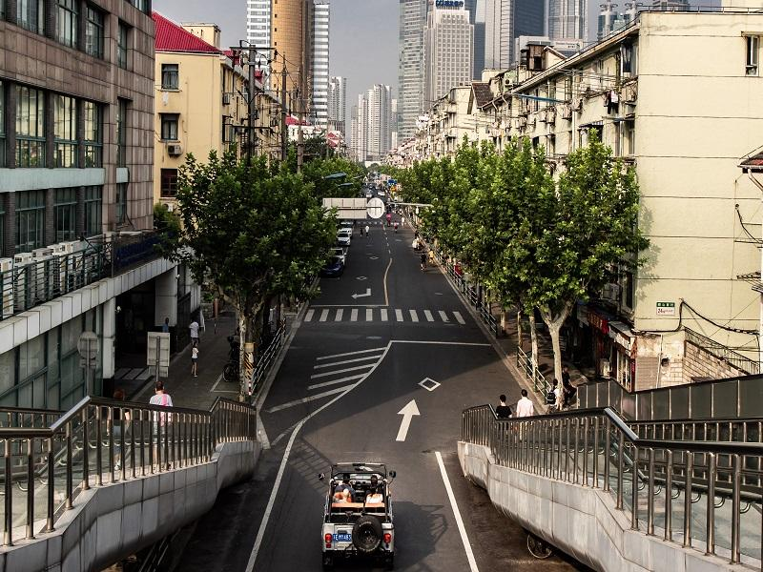
THE MODERN ARCHITECTURE RIDE BY JEEP
This is not your typical Shanghai tour! Zip around the streets in a vintage convertible jeep to see the city from a completely unique point of view. Led by a foreign expat to understand Feng Shui with the famous People Square

Slide 12
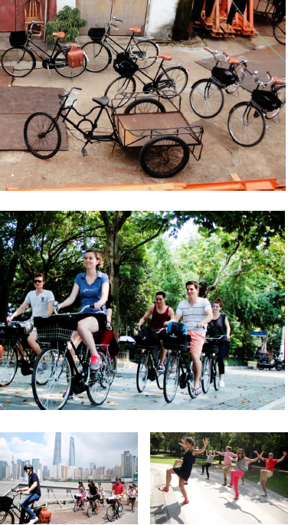

VINTAGE BICYCLE - OFF THE BEATEN TRACK
In just half a day with relax vintage bike tour, a diversified and interactive immersion into Shanghai local culture by visiting six iconic venues that emphasize the contrasts and souls of this city. To be on the same wave, we will use original China Pigeon Bike from the 40’ (restored, light and perfectly functioning)
Through this bike tour you will be actually really able to see different faces of the city at very close range. This is something you do not get with regular tour and an important and valuable insight of real life

Slide 13
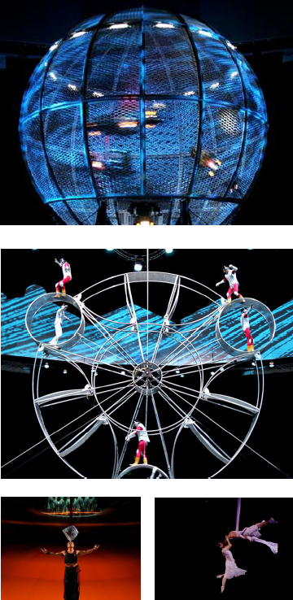

ERA SHOWS
The shows has become one of the most popular evening entertainments. As a multimillion-dollar stunning acrobatic extravaganza, the first of its kind in China, ERA is a multimedia odyssey whose inspiration is a direct result of the combination of traditional Chinese acrobatic arts and modern technology, not only will the audience be amazed by the acrobats’ control and precision, they will be enchanted by the world that is created through the use of multimedia, technology, lighting and sound effects, elaborate costumes, original live music and a lot more.

Slide 14
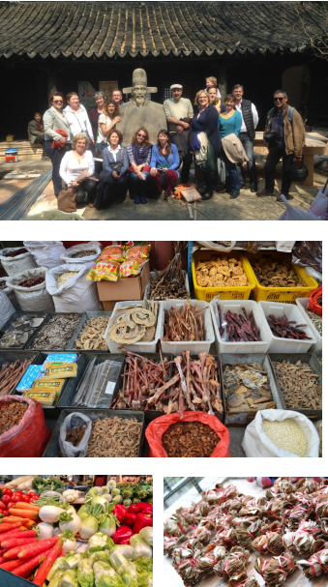

HEADING FONT:
ROBOTO Bold, 24 point
BODY TEXTS FONT:
ROBOTO, 12 point
TRADITIONAL CHINESE MEDICINE TOUR(s)
Half/Full day tour
Chinese market to introduce vegetables, fruits, etc in link with the principles of TCM
Visit a pharmacy and associated museum
Visit a TCM museum
To understand how TCM took from and develop and how Chinese people appy TCM to keep in good health during their daily life

Slide 15
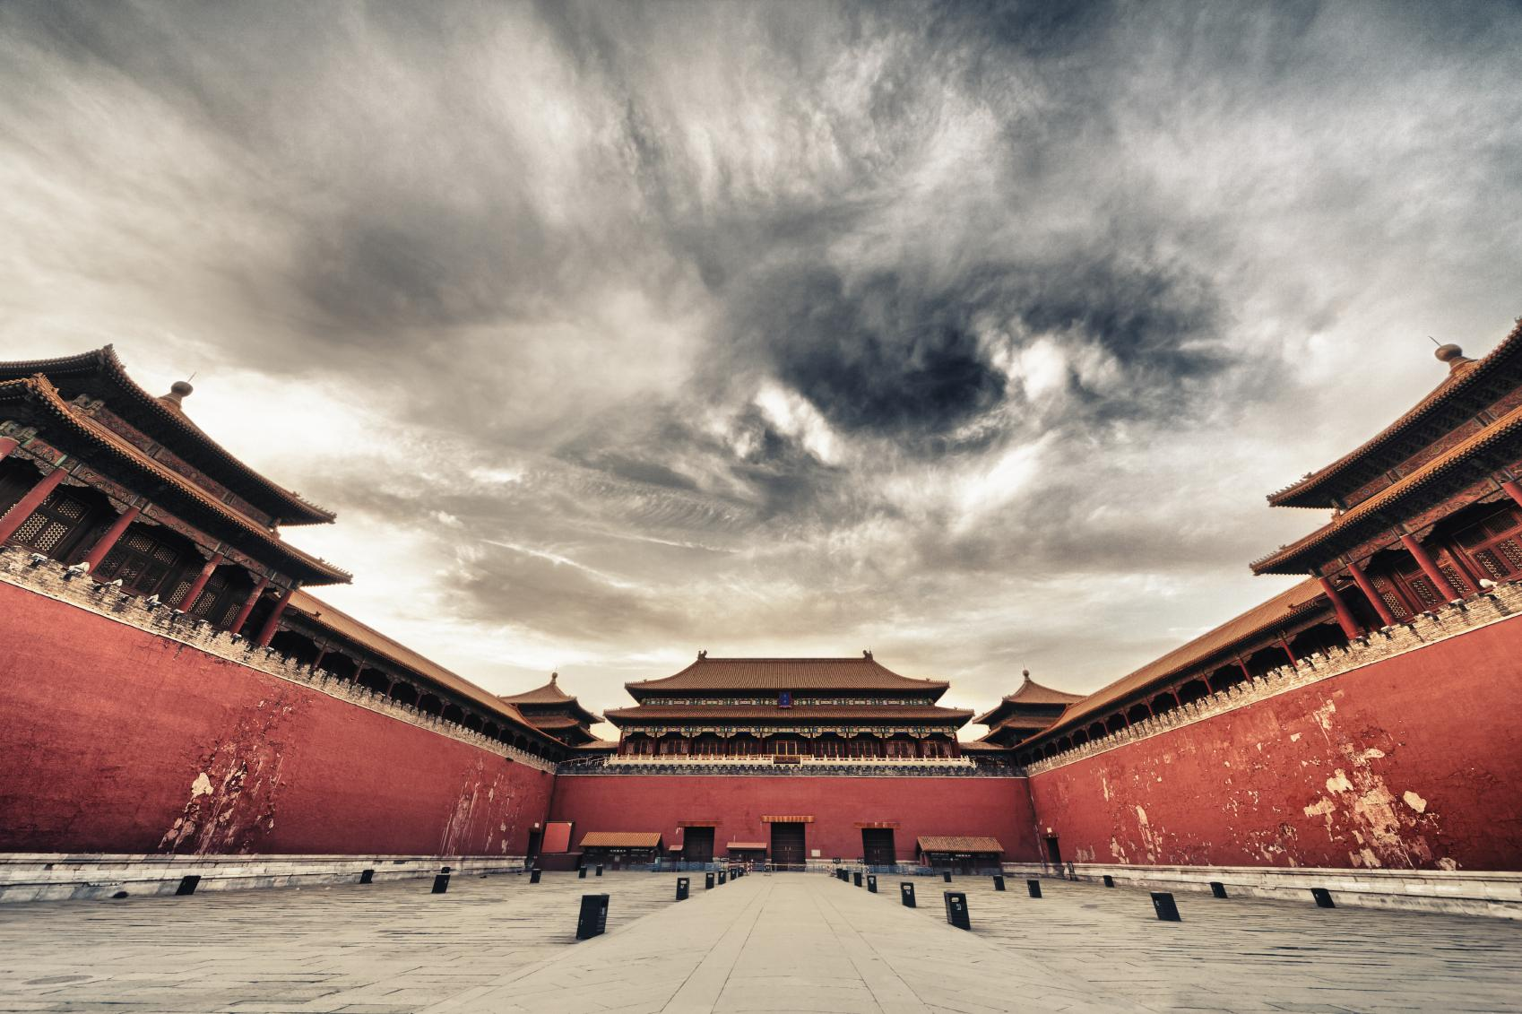
BEIJING

Slide 16
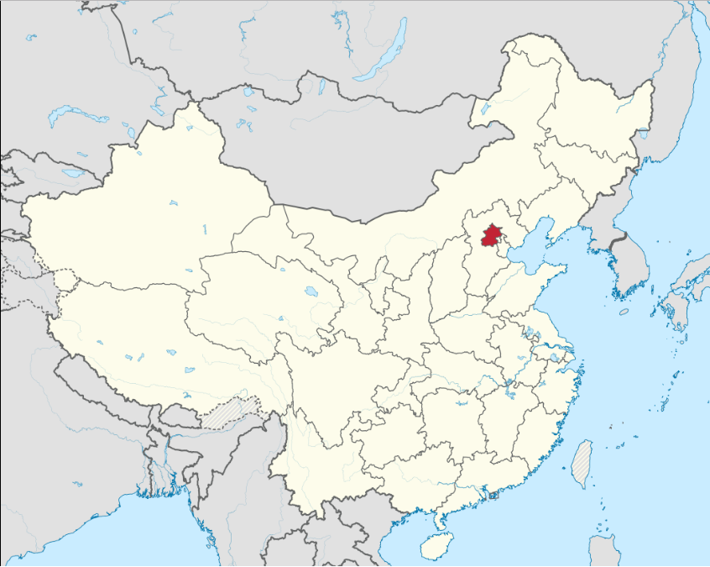
BEIJING

Slide 17
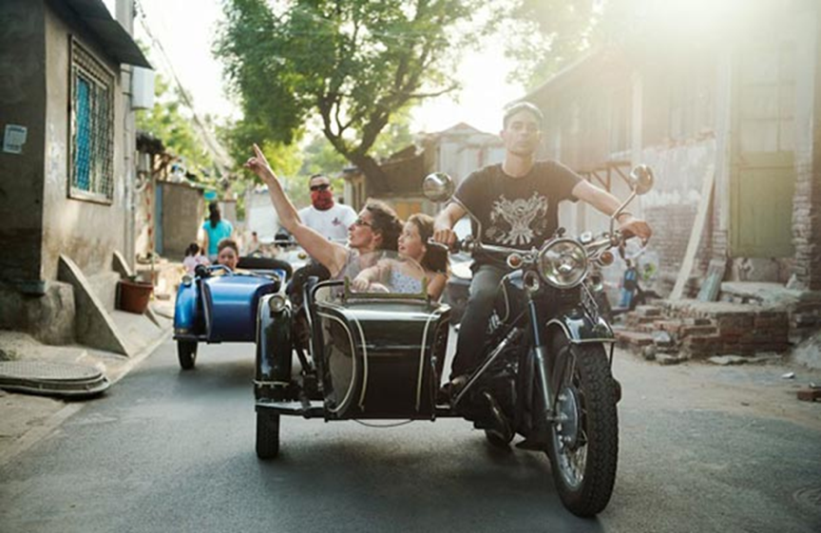
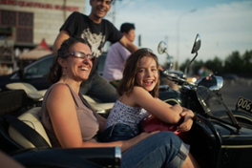

HEADING FONT:
ROBOTO Bold, 24 point
BODY TEXTS FONT:
ROBOTO, 12 point
BEIJING SIDECAR TOUR
This short sidecar trip gives you a first impression about the city, which enables you to decide where you want to spend more time during your stay in Beijing
Sitting in a sidecar, clanking through their gears past traffic jams and into the small alleyways of the hutongs, you have the experience of being local, close to the daily life of Beijing

Slide 18
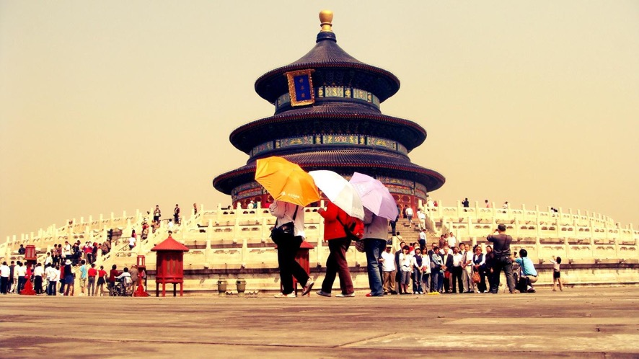
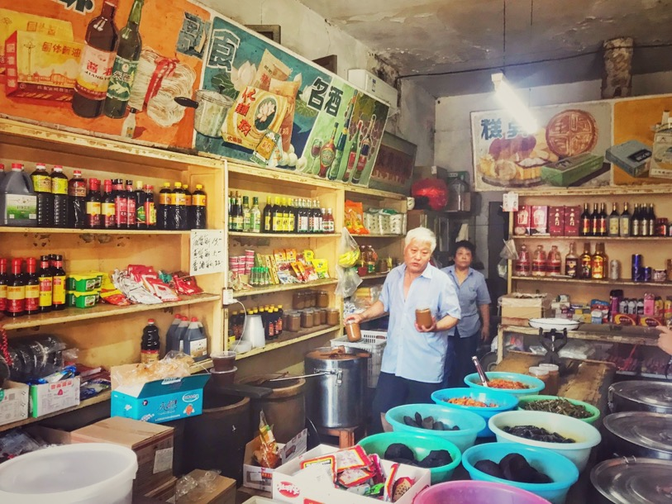

HEADING FONT:
ROBOTO Bold, 24 point
BODY TEXTS FONT:
ROBOTO, 12 point
WALKING TOUR(s)
- with specialists
Missionaries, Ministers and Musicians
A walk and Discussion in the Historic Hutongs of Beijing
In the footsteps of the Emperor
A walk and Discussion at the Temple of Heaven
The Ming and the Manchus
A walk and Discussion at the forbidden city
The dowager and the dynasty
A walk and Discussion at the Summer Palace
The Emperor and the Lama
A walk and Discussion at the Lama Temple and Confucian Temple

Slide 19
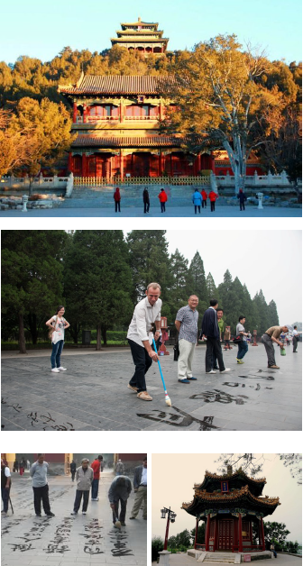

HEADING FONT:
ROBOTO Bold, 24 point
BODY TEXTS FONT:
ROBOTO, 12 point
WATER CALLIGRAPHY
Chinese people who believe that morning exercise is essential for their well-being, prepare for the day ahead with a mixture of Taiji, Kung Fu, meditation… One of the most unique practice is water calligraphy, using large brushes to write Chinese characters in water on the flagstones of the park
The activity will not only give you an insight into a major section of Chinese civilization but will be also a good opportunity to interact with local people

Slide 20
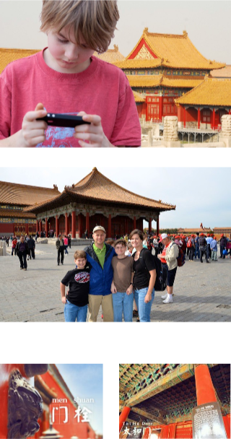

HEADING FONT:
ROBOTO Bold, 24 point
BODY TEXTS FONT:
ROBOTO, 12 point
SYMBOL HUNTING IN THE FORBIDDEN CITY
Explore Beijing’s iconic Forbidden City in a family-friendly way. Take part in a treasure hunt, seeking out special symbols found amid the 9,999 buildings of the compound. As the guide explains the site’s history and legends, listen carefully for clues. Then race through the Forbidden City to find the answers.

Slide 21

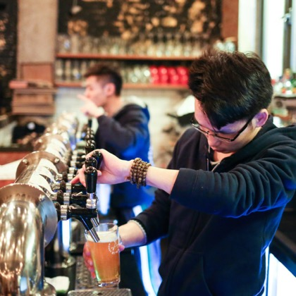
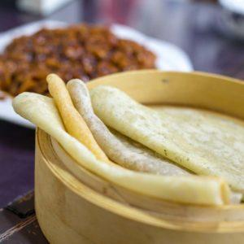
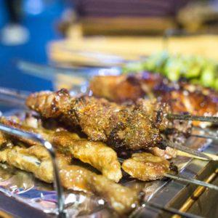
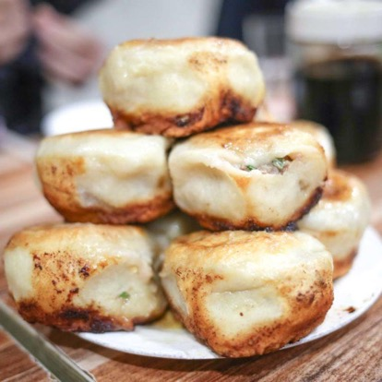
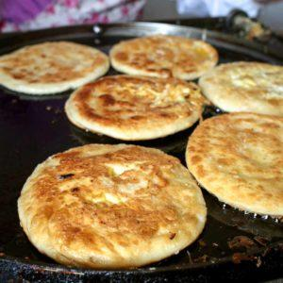
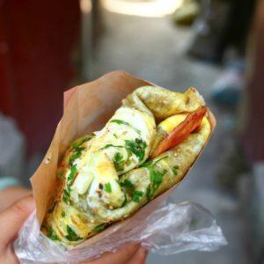
FOODIE TOUR(s)
Breakfast tour / Evening tour / Brewery discovery

Slide 22
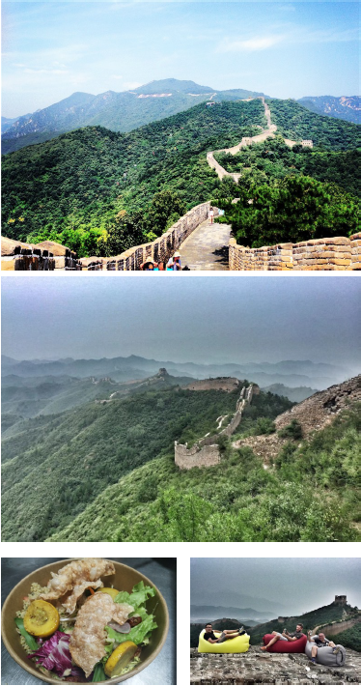

HEADING FONT:
ROBOTO Bold, 24 point
BODY TEXTS FONT:
ROBOTO, 12 point
LUNCH ON THE GREAT WALL
Not only hiking on the wall
Fresh food and drinks
Can upgrade to Luxury standard

Slide 23
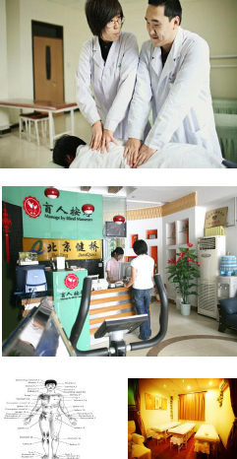

CHINESE BLIND MASSAGE
Blind massage has a long history in China (the first blind masseur is said to be the 8th-century Buddhist who practiced the treatment after losing his sight during old age), it was only in the late 1990s that blind massage clinics began to proliferate in the capital.
The key difference with blind massage is not in the treatment method, but in the person doing it. Giving a good massage is dependent on a person’s tactile sensitivity. Obviously, blind people have a strong advantage in this and so they have a good chance of finding employment!

Slide 24
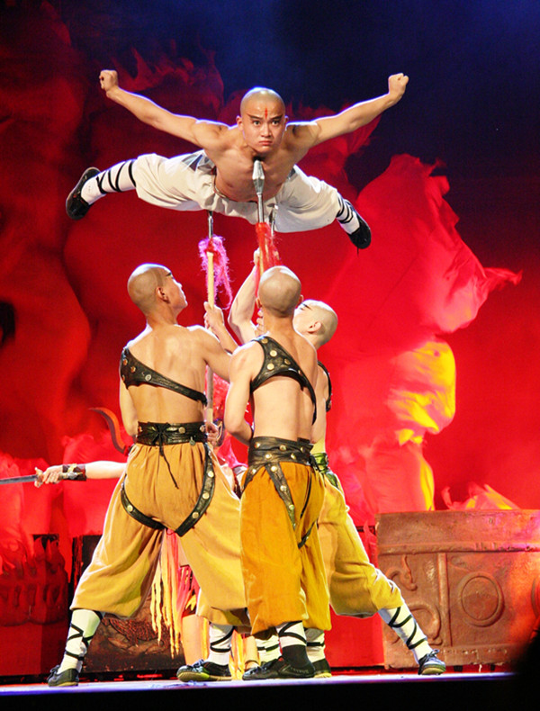

HEADING FONT:
ROBOTO Bold, 24 point
BODY TEXTS FONT:
ROBOTO, 12 point
KUNG FU SHOW
The Chinese Kung Fu is popular terms with Chinese martial arts, trace its origins back some 4000 years ago to self-defense need, hunting activities and military training in ancient China
The Red Theater is originally known as Chongwen Workers Cultural Palace Theater. After the renovation, the stage facilities has been dramatically improved and now the theater specializes in traditional Chinese performances, such as “The Legend of Kung Fu”

Slide 25
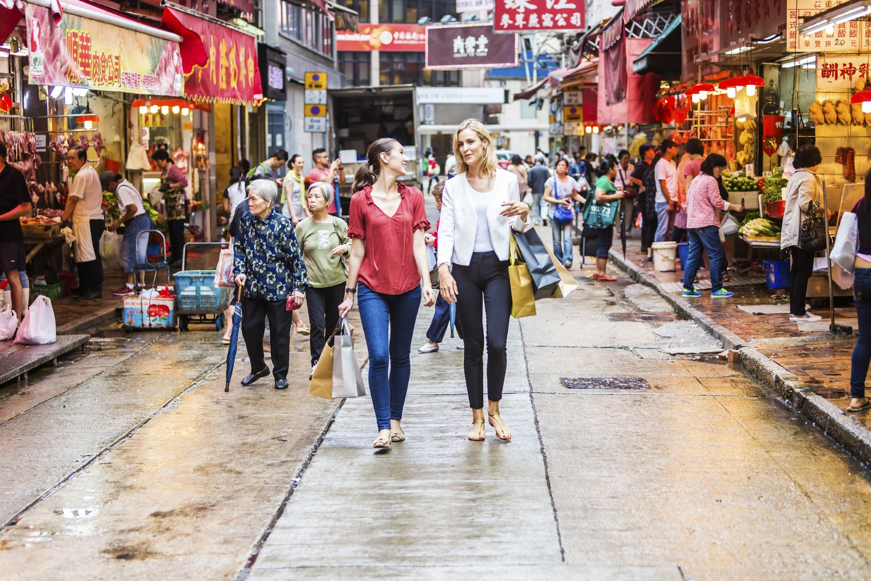
HONG KONG

Slide 26
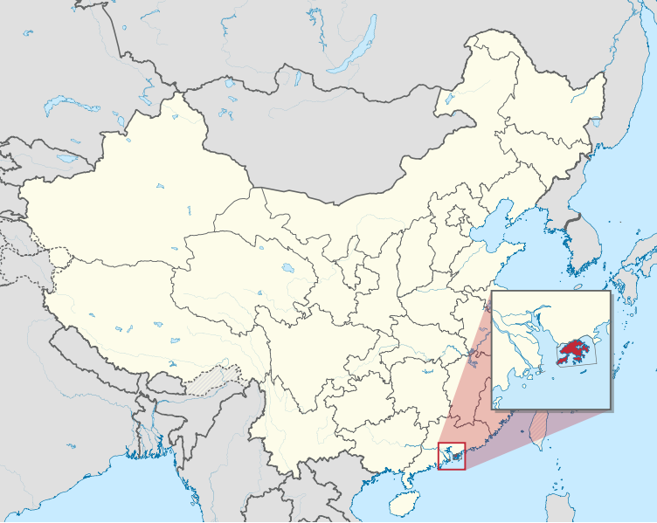
HONG KONG

Slide 27
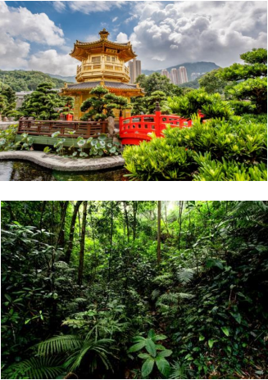
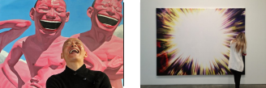
WALKING TOUR(s)
lead by specialists
Temple and Feng Shui walking tour
Geopark Hong Kong walking tour
Private Art Tour

Slide 28
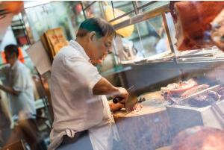
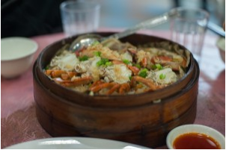
FOODIE TOUR(s)
Central & Sheung Wan foodie tour
Sham Shui Po foodie tour
Temple street night foodie tour
Tai Po Market foodie tour

Slide 29
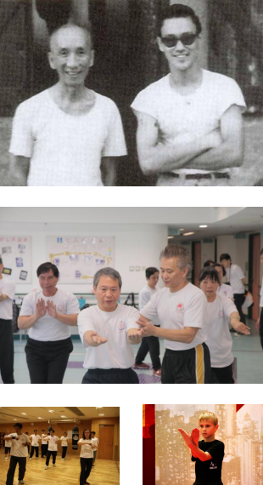
WING CHUN KUNG FU CLASS
Wing Chun Kung Fu was developed in southern China over 300 years ago. It is both a hard and soft style of Kung Fu. Wing Chun initially was a guarded secret and only a select few were lucky enough to become students but now mainly through the legacy of Yip Man, who famously taught Bruce Lee, it is practiced throughout the world

Slide 30
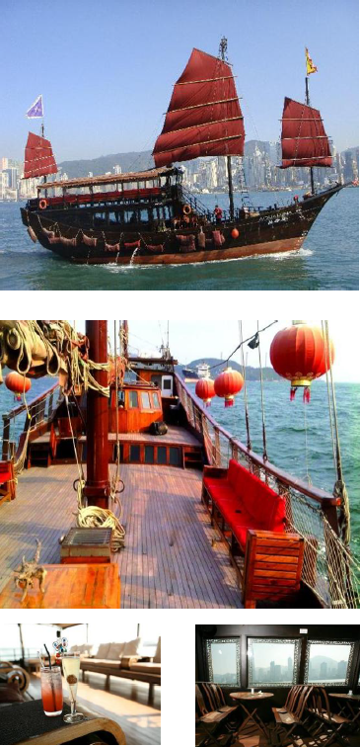
AQUA LUNA
Aqua Luna is one of Hong Kong’s last remaining red-sail Chinese junk boats. Lie back in the comfortabel of your own sofa bed, indulge in one of Aqua Luna’s ship cocktails and soak in Hong Kong’s stunning harbor views and skyline. Possibly the last handcrafted traditional Chinese junk to be built in Hong Kong using age old designs and traditional materials by an 80 years old local craftman

Slide 31
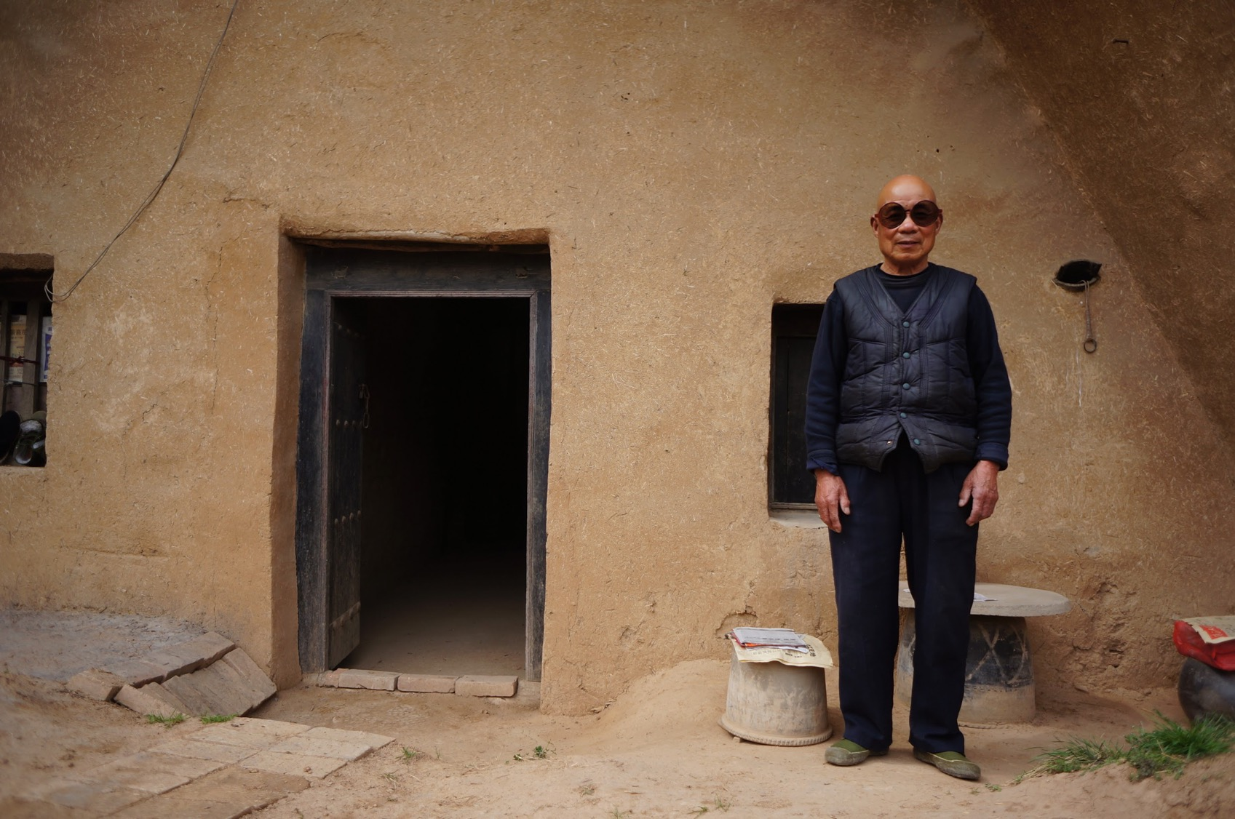
XI'AN

Slide 32
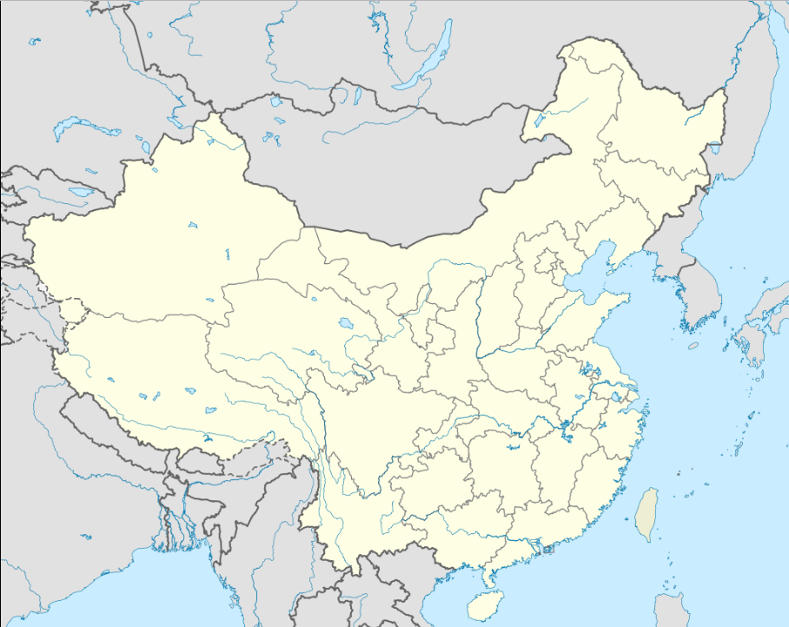
XI'AN

Slide 33
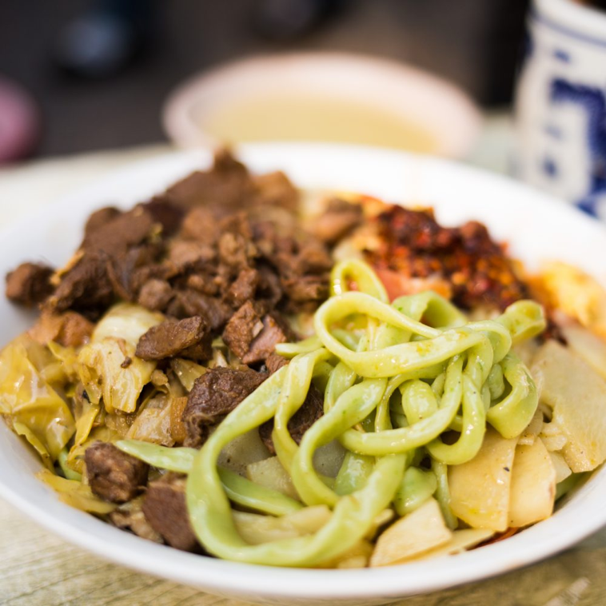
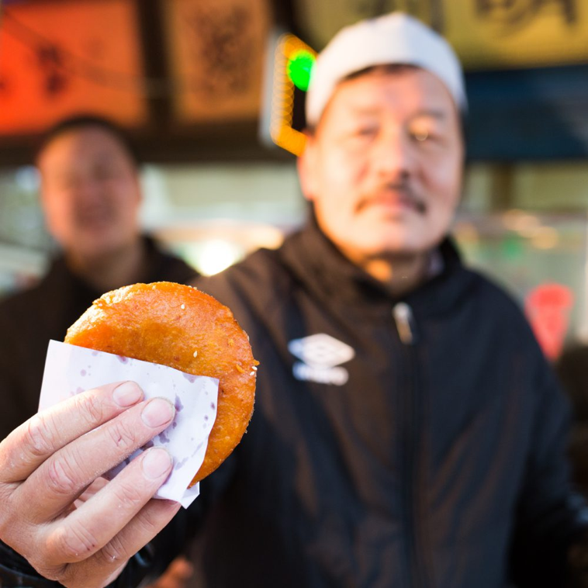
FOODIE TOUR(s)
Evening foodie tour
Breakfast & Market tour

Slide 34
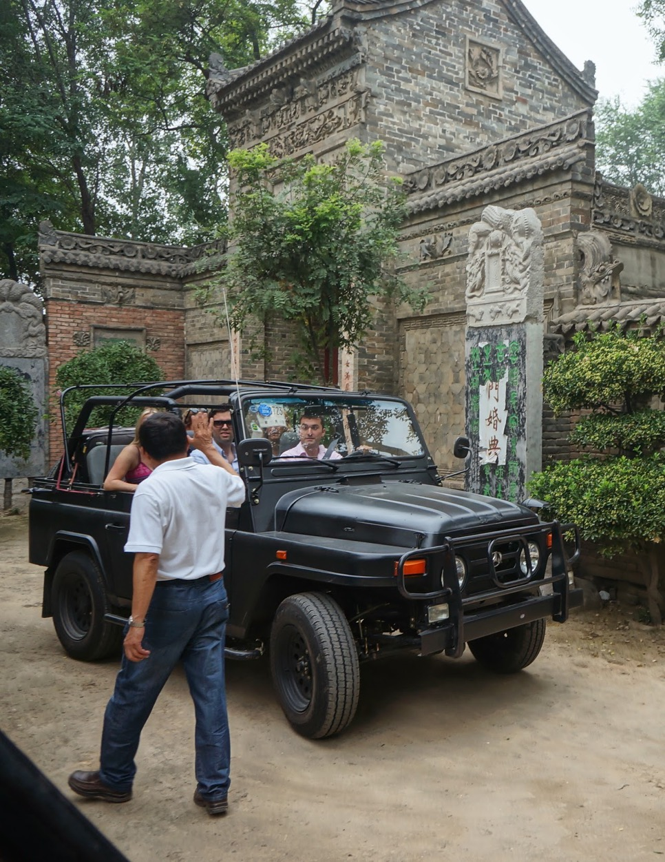
JEEP TOUR(s)
Visit Terracotta Warriors
By vintage jeep
Go through local villages
Out off beaten track
CONTENT FONT:
ROBOTO, 10-14 point
(Depends on how long of the texts

Slide 35
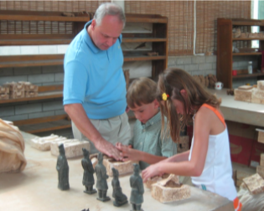

ARTIFICIAL TERRACOTTA WARRIOR
This activity will not only give you an insight into a major section of Chinese civilization but will be also a good opportunity to interact with local people that are generally very keen to share their knowledge with foreigners!

Slide 36

THE TANG DYNASTY DINNER SHOW
The show depicts wonderful music and dance from the ancient civilization. While enjoy the show, you would be bring back to the ancient Tang Dynasty time
CONTENT FONT:
ROBOTO, 10-14 point
(Depends on how long of the texts

Slide 37

SICHUAN

Slide 38

SICHUAN

Slide 39


FOODIE TOUR(s)
Sichuan Hotpot, Tea & Market experience
Evening foodie tour by Tuk Tuk

Slide 40


HOME-STYLE COOKING CLASS
Visit the local market in the morning, which is essential in having a some basic knowledge of chinese condiments and cooking ingredients.
Then you will be arrange to have a home -style cooking class and learn how to make classic Sichuan cuisine.

Slide 41

VOLUNTEER IN PANDA BASE
Help Panda keeper wash and pick out bamboo
Cleaning Panda’s villa house
Make “Panda Wowotou” for feeding
Understand Panda’s habits and characteristics

Slide 42


BAMBOO BIKE TOUR
Ride a handmade Bamboo bicycle to explore the ancient city of Chengdu.
Visit local riverside gardens and parks to discover the city’s rich history.
Meet a hidden Tibetan community and learn about their culture outside of the Tibet Plateau.

Slide 43

HEADING FONT:
ROBOTO Bold, 24 point
BODY TEXTS FONT:
ROBOTO, 12 point
CHUAN OPERA
One of the oldest and most interesting opera forms in Southwestern China, Sichuan Opera is a perfect blend of local dialect along with the customs, folk music and dances from other regions. Sichuan Opera is known for three distinct features, Changing Faces, Spitting Fire and Rolling Light
Have an opportunity to go to the backstage to see artistes make up and have a chance to do your own make up

Slide 44

GUANGXI

Slide 45

GUANGXI

Slide 46


COOKING CLASS
Before cooking, you will be taken to visit a local food market to learn about the ingredients that we use in our dishes.
Learn how to cook real local food with our skilled and friendly teachers who love to impart the stories and secrets of Chinese cuisine in a friendly fun atmosphere.

Slide 47

RAFTING
Rafting is a nice and relaxed way to enjoy the sight of Karst landform in Yangshuo
Get nice visual angles to enjoy this natural magical masterpiece
Rafting can do different section of the river

Slide 48

PAPER-FAN PAINTING
The class is available in Fuli old town, the hometown of Chinese painting fan
The class is provide by local skilled paper-fan making craftsman

Slide 49

BIKING TOUR(s) IN YANGSHUO
A scenic cycle tour of Yangshuo’s surrounding villages and spectacular landscapes
Yangshuo is famous for its Karst mountain scenery and rural landscapes. It was “discovered” by backpackers in the early 90’s as a tranquil retreat from the city of Guilin
Enjoy the beautiful view of Karst Mountain, while exploring local history and culture

Slide 50


ROCK CLIMBING & KAYAKING
IN YANGSHUO

Slide 51

IMPRESSION LIUSANJIE SHOW
The musical night show directed by Zhang Yi Mou, who is the director of 2008 Beijing Olympic Opening Ceremony. Using Lijiang river and hill as its stage, combine the folk song culture, fishermen culture, ethnic group culture and modern lighting effects, the happened in this beautiful place
This is the world largest nature theater

Slide 52

YUNNAN

Slide 53

YUNNAN

Slide 54



Lijiang
Old town but small villages like Shuhe where around Lijiang are even better
Tiger Leaping Gorge
Hiking around the gorge can be arranged
Zhongdian
Local life, culture
Deqin or Shangri-la
Tibetan world
CONTENT FONT:
ROBOTO, 10-14 point
(Depends on how long of the texts

Slide 55

HEADING FONT:
ROBOTO Bold, 24 point
BODY TEXTS FONT:
ROBOTO, 12 point
ROCK CLIMBING IN SHIGU OLD TOWN
Climbing is arranged in a valley of Shigu town, where have developed 100 climbing routes, which are available for different classes climber
Enjoy the pleasure of climbing activity in a beautiful valley

Slide 56

HEADING FONT:
ROBOTO Bold, 24 point
BODY TEXTS FONT:
ROBOTO, 12 point
THANGKA ACADEMY
The academy is part of the Shangri La association. It was founded by a group of volunteers dedicated to protect local ethnic culture and ensure it is preserved for future generations. Originally created to help local Tibetan people learn the traditional techniques of Thangka, now the program has expanded to anyone who wants to learn more about Tibetan culture

Slide 57

HEADING FONT:
ROBOTO Bold, 24 point
BODY TEXTS FONT:
ROBOTO, 12 point
TEA-TRAIL CARAVAN
Walk, discover new valleys, climb highlands, turn around mountains with pilgrims camp, share the march during the day, stay with nomad shepherds, explore and live the Tibetan Plateau in total freedom

Slide 58


HEADING FONT:
ROBOTO Bold, 24 point
BODY TEXTS FONT:
ROBOTO, 12 point
DONGBA CULTURE CLASS
The class is about the Dongba character at Yuhu Village
The Dongba character is ancient character used by Naxi people

Slide 59


BLACK POTTERY DIY CLASS
IN A NAXI VILLAGE

Slide 60

TAIWAN

Slide 61


HEADING FONT:
ROBOTO Bold, 24 point
BODY TEXTS FONT:
ROBOTO, 12 point
EXPERIENCES
Taipei Northern Coast Tour
Pingxi Sky Lantern Experience & Old Street Walk
Taipei Night Tour
Yangmingshan National Park & Hot-Spring Tour

Slide 62

HEADING FONT:
ROBOTO Bold, 24 point
BODY TEXTS FONT:
ROBOTO, 12 point
CLASSIC TAIWAN
13D12N
The main island
Culture, local life (for example in Taipei)
Adventure, nature (for example in Sun Moon Lake and Alishan)
Beautiful beach (for example in Kending)
Taipei
Hualien
Sun Moon Lake
Tainan
Taitung
Kaohsiung
Kending

Slide 63




HEADING FONT:
ROBOTO Bold, 24 point
BODY TEXTS FONT:
ROBOTO, 12 point

Slide 64

THE SILK ROAD

Slide 65




Zhangye
Jiayuguan
Dunhuang
Turpan
Urumqi
Kashgar
Taxkorgan
CONTENT FONT:
ROBOTO, 10-14 point
(Depends on how long of the texts

Slide 66

INSIGHT OF ETHNIC VILLAGES IN GUIZHOU

Slide 67


Delve into China’s southwestern Guizhou province for a wholly unique ethnic village experience. Home to a vibrant array of hill tribes, this region is known for its traditional architecture, natural beauty and cultural enclaves. Experience five eclectic regions, each offering their own distinct attractions and appeals.

Slide 68

Lost Road
Classical China
With A Twist

